Slide 1
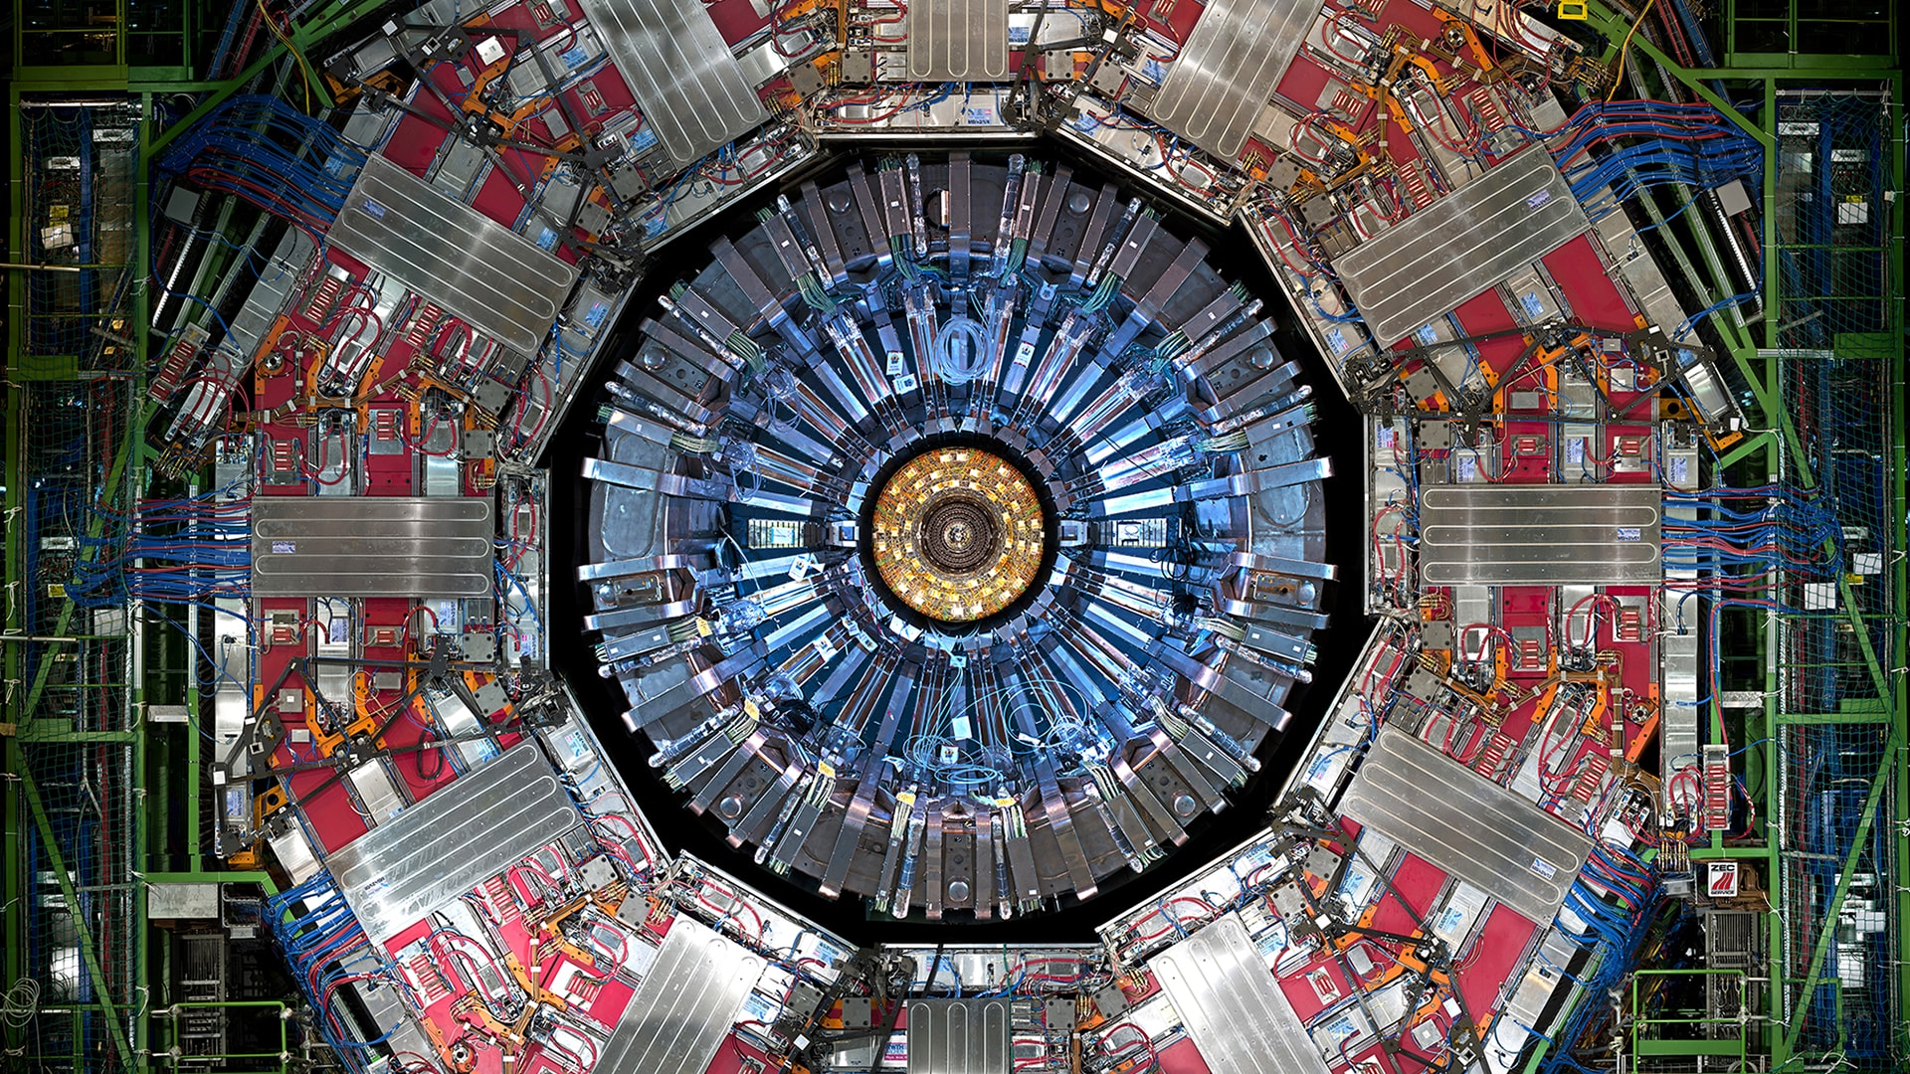
Chapter 1. Introduction

Slide 2
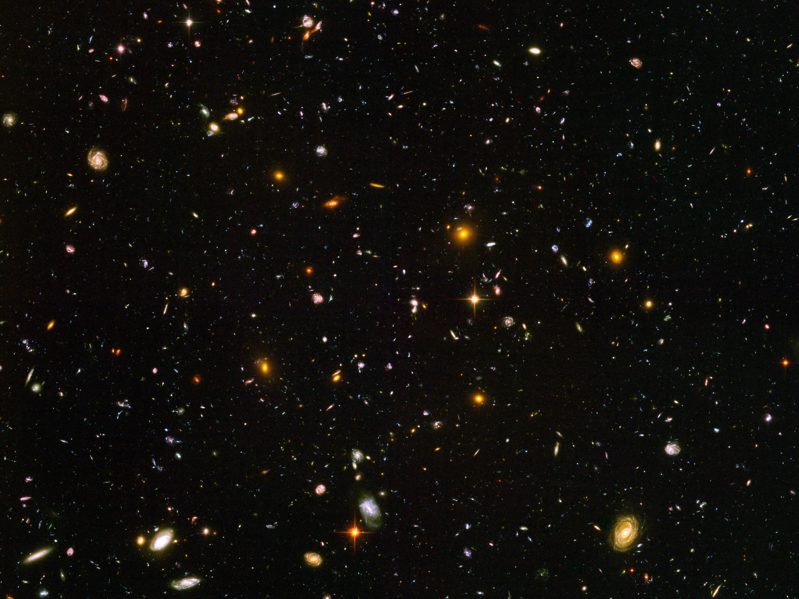

Slide 3
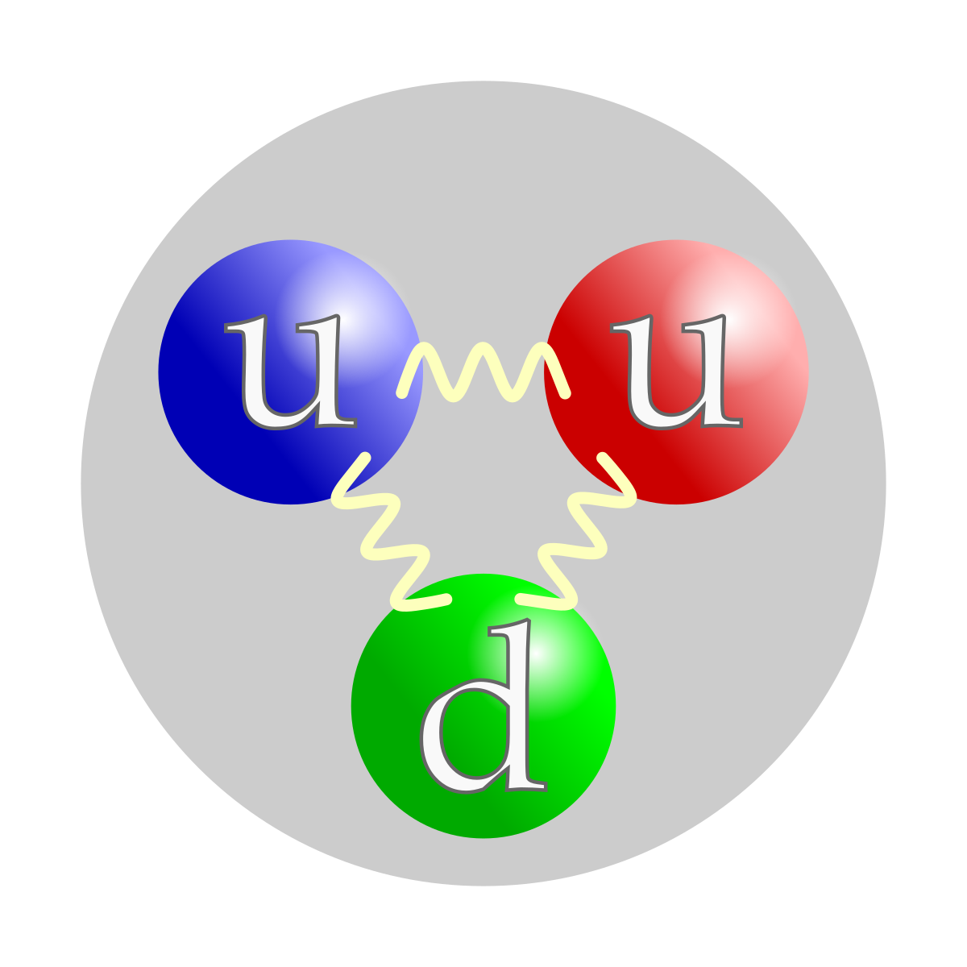
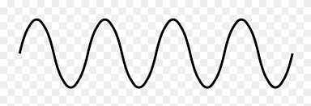
What is Particle Physics?
Subject that studies the fundamental components of Nature and their interactions
Nowadays our knowledge about fundamental particles is condensed in the Standard Model
Experimental foundation:
Collision experiments at higher and higher energies to reveal the features of the particles
Need higher energies to explore smaller and smaller spatial scales
Theoretical foundation:
Quantum Field Theory built on top of Quantum Mechanics and Special Relativity
The history of Particle Physics is the history of achieving larger and larger energies
λ
d
Debroglie:
Wave-Particle duality
Wave properties:
To resolve an object λ ~ d

Slide 4
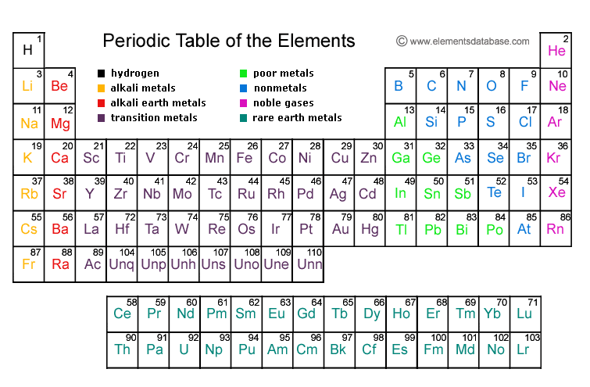
History of Particle Physics: beginnings XIX century
Dalton postulates that all substances might be composed of single units or atoms
As a consecuence of his observations in chemical reaction experiments
In the late 1800 the atoms were being classified according to the properties
This consolidates with the development of the periodic table by Mendeleev

Slide 5
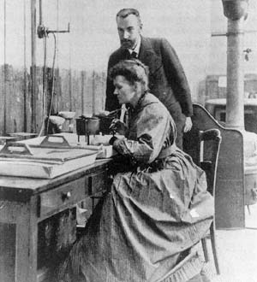
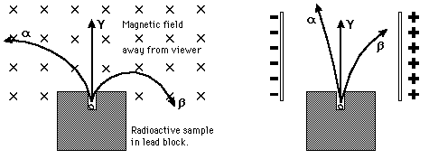
History of Particle Physics: decade of 1890
New unstable elements being investigated by M. and P. Curie, H. Bequerel and E. Rutherford
Radioactivity: spontaneous emission of particles from some species of atoms
At this moment it was determined that there were 3 different kinds of radiation:
Radiation α → 2 electric charge and about 4 times proton mass
Radiation β→ -1 electric charge and about 1/1800 the proton mass
Radiation γ→ electrically neutral

Slide 6
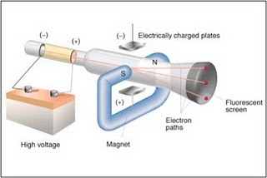
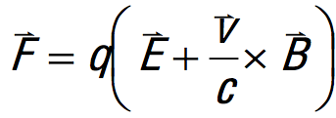
History of Particle Physics: discovery of the electron
For a number of years physicist have generated “cathode rays”
By simply heating filaments inside gas-filled tubes and applying an electric field
In 1987 J.J. Thompson attempted to measure the ratio of charge/mass of cathode rays
Put a cathode ray into a known electric or magnetic field
Measure the cathode ray’s deflection
If they are composed of discrete charges → deflection compatible with Lorentz force
Thompson found that this ratio was ~ 1000 larger than for any known ion
He concluded this was a new kind of particle and named it “electron”
m_{e}= 0.511MeV/c²

Slide 7
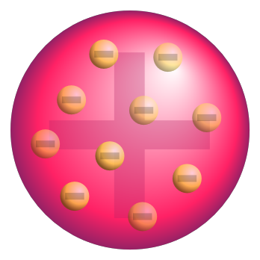
History of Particle Physics: Thompson’s atom model
Thompson correctly believed that electrons were fundamental components of the atoms
Since atoms were electrically neutral he postulated that point-like electrons should be somehow embedded in a “gel” of positive charge to yield a global neutral charge
This is the origin of the famous “plum- pudding” atom model
positively charged “paste”
localized electron (negative charge)
Thomson’s plum-pudding model of the atom.

Slide 8
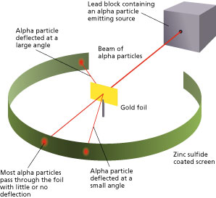
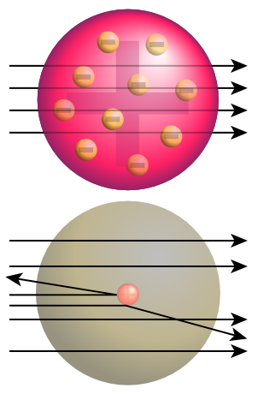
History of Particle Physics: Rutherford’s experiment
In the first years of the XX century E. Rutherford wanted to test Thompson’s model
With this purpose he proposed a setup to make a “scattering” experiment:
Bombing a very thin gold foil with αparticles and observing the deflection
If Thomson’s model was correct theαparticles shold not reflect much

Slide 9
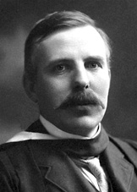
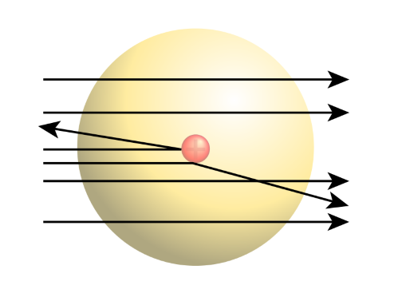
History of Particle Physics: Rutherford’s experiment
Rutherford observed that a few particles were having a huge deflection (> 90º)
He wondered what was the origin of such a strong force able to invert the sense of the particles
The only possibility was some kind of electric force made by another very close-by particle
He concluded that the positive charge of the atom should be concentrated in small region
This is the discovery of the nucleous
The distance d should be very small to produce such a large F
$F∝\frac{q_{1}q_{2}}{d^{2}}$

Slide 10
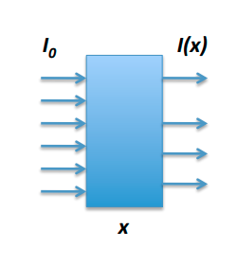
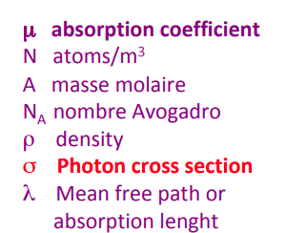
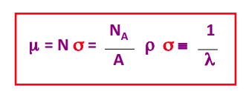
Photon interactions
Since photons do not have charge they are always indirectly detected:
In their interactions they produce electrons/positrons that interact with matter
Photons may be absorbed (photoelectric effect or e⁺e⁻ creation) or scattered (Compton effect)
An attenuation law is introduced based on the fact that the interaction probability is constant
$I\left(x\right)=I_{0}e^{−μx}$

Slide 11
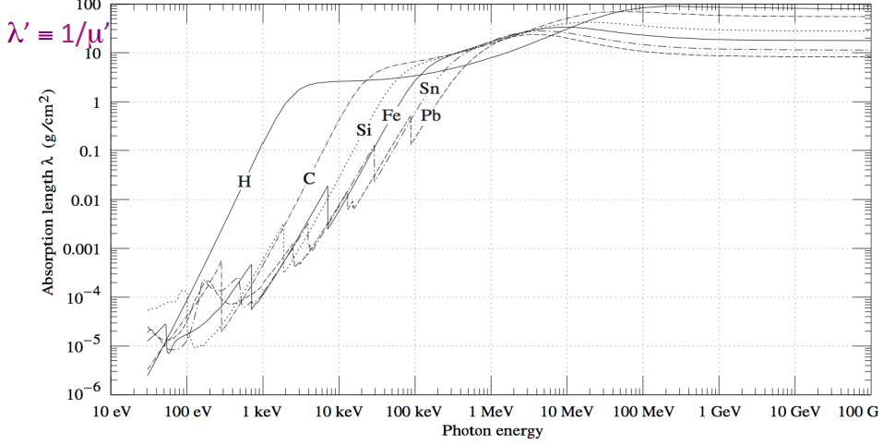
Photon absorption length
Frequently instead of working with the distance we use the distance times density
This quantity is more sensitive to the real amount of matter in the crossed distance
$x'=xρ$
$I\left(x\right)=I_{0}e^{−μx}$
$μ'=μ/ρ$
$I\left(x\right)=I_{0}e^{−μ'x'}$
$λ'=1/μ'$

Slide 12
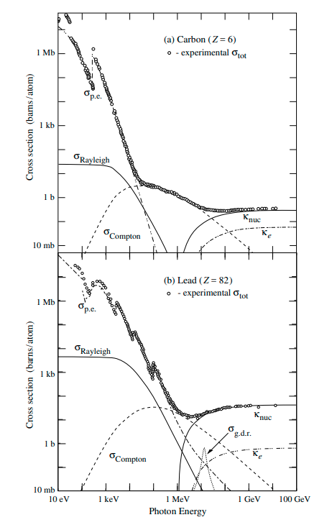
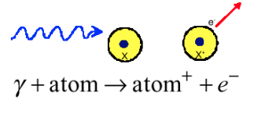
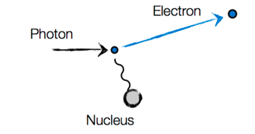
Photoelectric effect
Photoelectric effect
The energy of the photon is transferred to the electron
The photon is absorbed and the electron is extracted
The atom gets ionized
The final energy of the electron depends on the binding energy (the electron energy level in the atom)
Photoelectric effect
$E_{e}=hν−E_{ebinding}$
Different trends at low and high energies
$σ∼{Z^{5}}/{E_{γ}^{3.5}}$
$σ∼{Z^{5}}/{E_{γ}}$

Slide 13
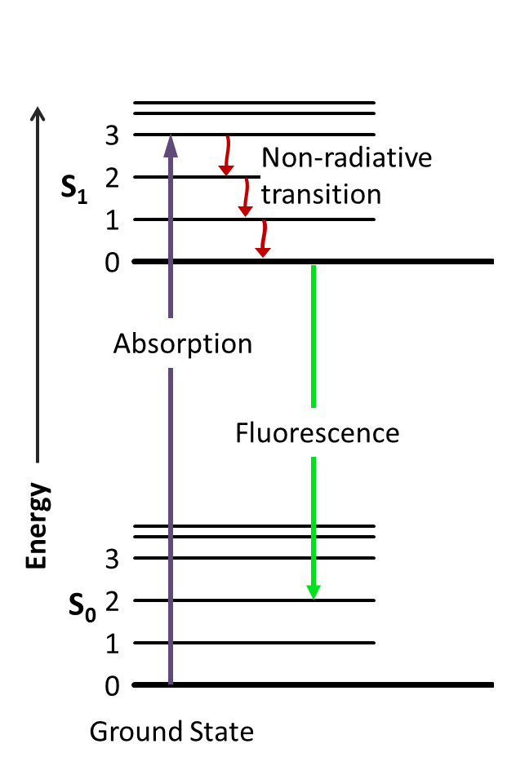
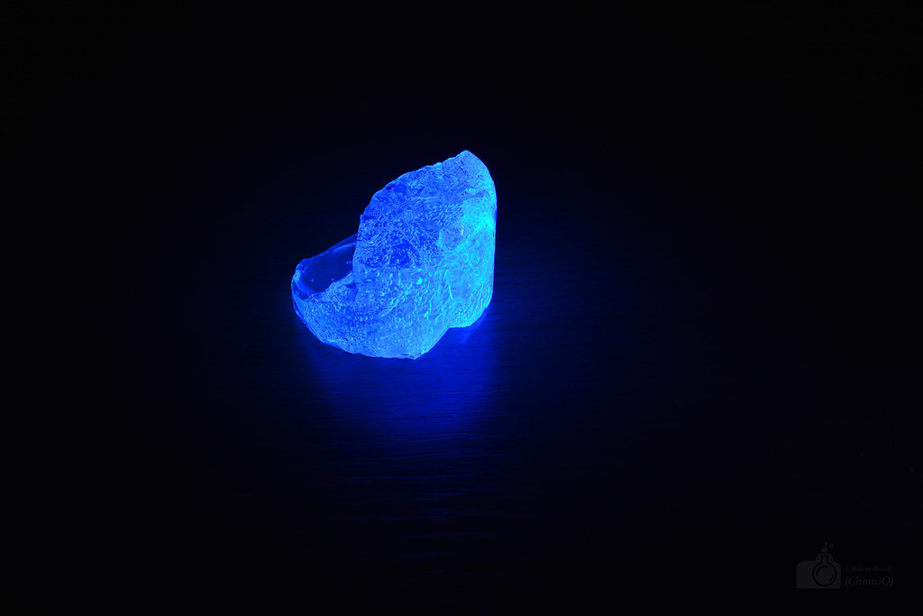
(After) Photoelectric effect: fluorescence
After the emission of a photoelectron the ionizedatom (molecule) is an excited state
The ionized atom (molecule) returns to the ground state emiting photons
This is an important effect in a kind of active materials called: scintillators

Slide 14
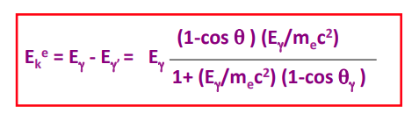
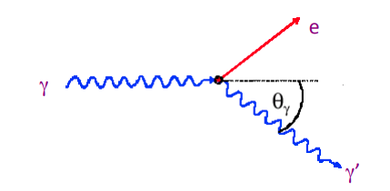
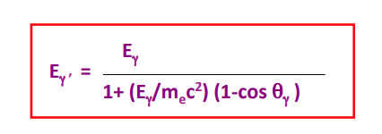
Compton scattering
Scattering of light on free electrons (if E_{photon}>>E_{binding} a binded electron is considered free)
When the angle is 0 the initial photon gives all its energy to the outgoing photon
When the angle is backwards the outgoing electron has maximum energy
And the outgoing photon minimum energy but it cannot get completely absorbed

Slide 15
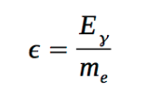
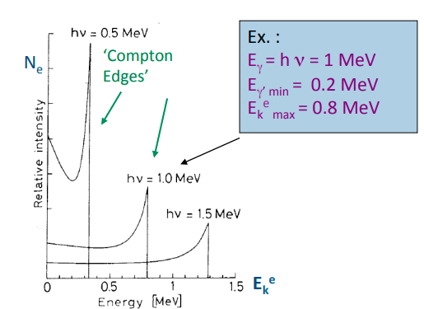
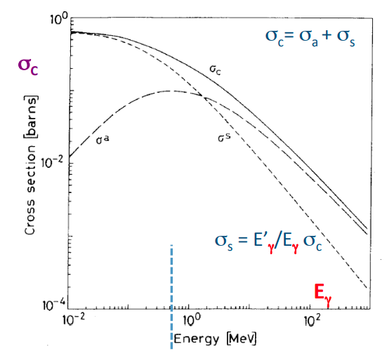
Compton edges and cross section
The photon can never give all its energy to the electron producing the so called “edges”
The cross section is given by the Klein-Nishina formula

Slide 16
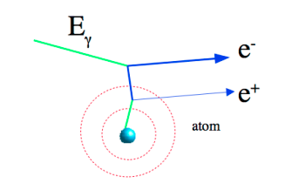
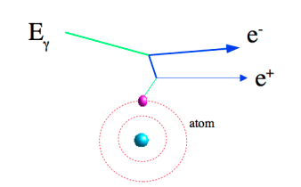
Pair production of electron-positron
The photon interacts with the field of a nucleus or electron and makes a pair e⁺e⁻
This process cannot take place in the vacuum because of energy-momentum conservation
Pair production in the field of a nucleus
Pair production in the field of an electron
It is also frequently known as “photon conversion”
This effect is a “threshold effect”: the photon energy has to be enough to generate 2 electrons
$m_{x}=\left\{\begin{aligned}m_{N} \\ m_{e}\end{aligned}\right\}$
$E_{γ}>2m_{e}c^{2}\left(1+{m_{e}}/{m_{x}}\right)$

Slide 17
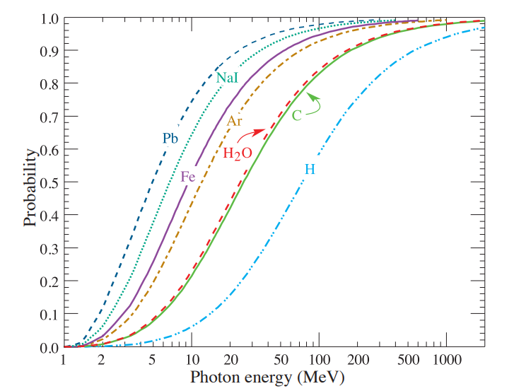
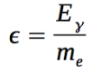
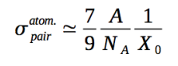
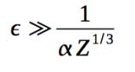
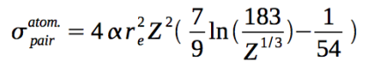
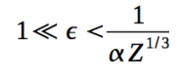
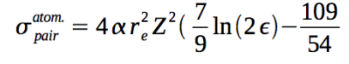
Pair production of electron-positron
The cross section of pair production rises one the threshold has been reached
Three different regions: “low”, “medium” and “high” (saturation) energy regimes
Saturation
$ε→∞$
Medium
Low

Slide 18
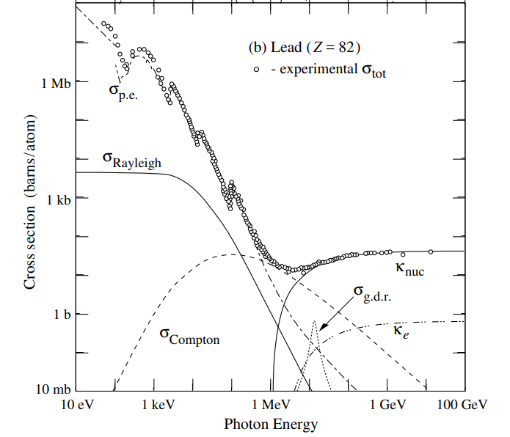
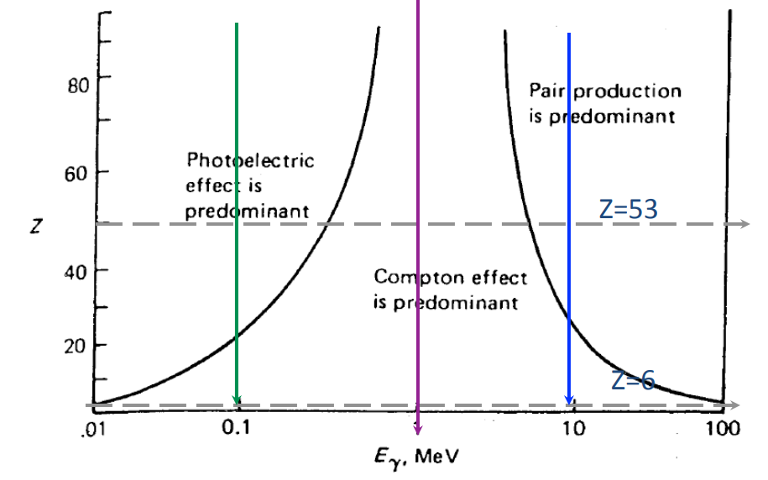
Photon total cross section
Photoelectric effect dominates at low, Compton at medium and pair production at high E
Compton dominates for low Z materials (photoelectric and pair production increase with Z)
Other processes not treated here: Raylaigh scattering, photo nuclear interactions
Photoelectric
Compton
Pairs

Slide 19
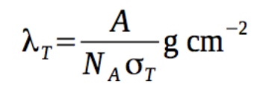
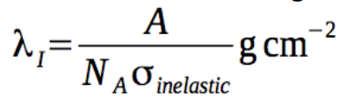
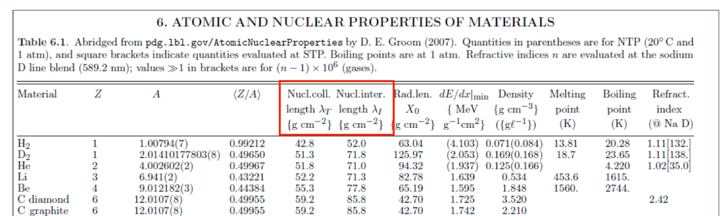
Hadron collisions and interaction lenghts
The total cross section for very high energy hadrons is expressed as:
The inelastic part of the total cross-section is susceptible to induce hadron showers
Two mean lenghts are introduced to deal with this kind of interactions
Nuclear collision length:
Mean free path of a particle before undergoing a nuclear interaction
Nuclear interaction length:
Mean free path of a particle before undergoing an inelastic nuclear interacion
$σ_{T}=σ_{elastic}+σ_{inelastic}$

Slide 20
Neutron interactions
Neutrons interact via the “strong interaction” with nuclei (short range force ~ 10⁻¹³ cm)
Classification of neutrons:
Cold or ultracold neutrons E_{n} < 0.025 eV
Thermal or slow neutrons E_{n} ~ 0.025 eV
Intermediate neutrons E_{n} ~ 0.025 eV – 0.1 MeV
Fast neutrons E_{n} ~ 0.1 MeV – 10-20 MeV
High energy neutrons E_{n} > 20 MeV
Low-moderate energy neutrons
Scattering
Absorption
Fission
High energy neutrons
Hadron shower production

Slide 21
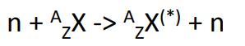
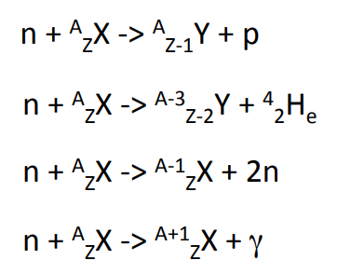
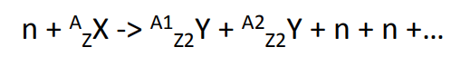
Low-intermediate energy Neutron interactions
Scattering with nuclei (important for moderation):
The neutron changes energy and the nucleus gets in an excited state
Absorption and nuclear reactions (the neutron is absorbed and a nuclear reaction takes place)
Low A-Z transitions (typically emission of a proton, alpha particle, or neutrons)
Fission process: the nucleus is splitted in two and more neutrons are produced
High A-Z transitions
Importan for chain reactions in nuclear reactors

Slide 22
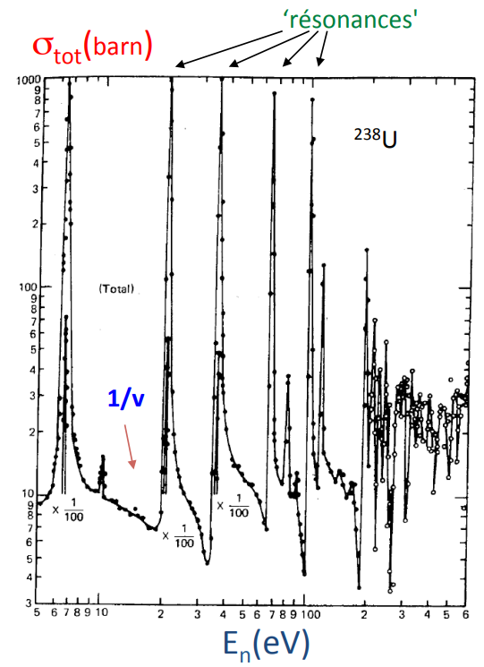
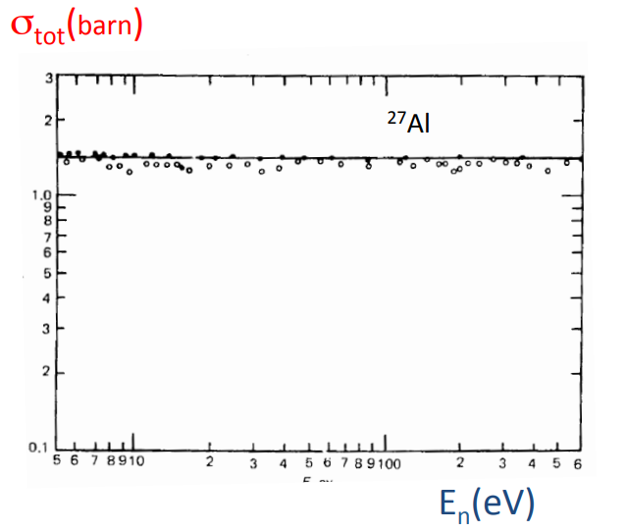
Low-intermediate energy Neutron cross sections
The cross-section goes like ~ 1/v_{n} with v_{n} the velocity of the neutron
On top of this effect there are the absorption resonances characteris of every nucleus

Slide 23
Charged particle interactions
Charged particles suffer a wide variety of different interactions
Ionization
Bremsstrahlung
Multiple scattering
Cerenkov
Nuclear interactions

Slide 24
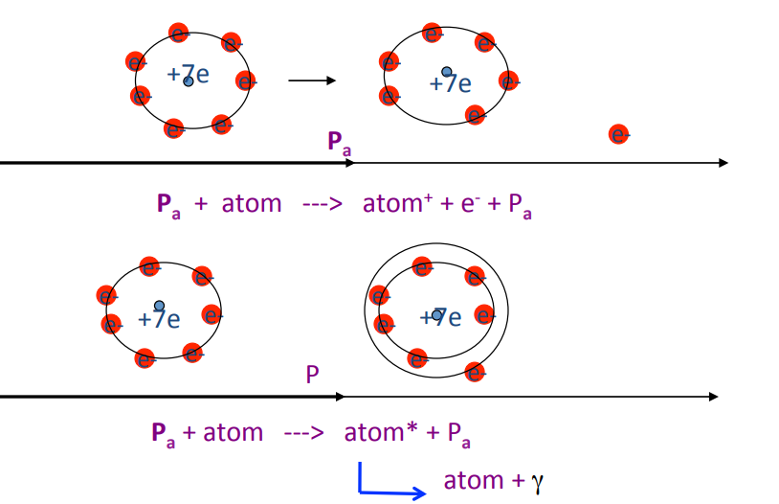
Inelastic collisions with atom electrons (Ionization)
The charged particle interacts, giving energy, with the electron of an atom
This process is dominant for heavy charged particles M_{pa} >> m_{e}
Ionization
Excitation
Inelastic collisions on the nucleus are much less frequent (because the mass is much higher)
The particle loses a bit of energy and its direction remains mostly unchanged

Slide 25
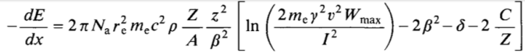

Inelastic collisions with atom electrons (Ionization)
The avarage energy loss of a particle due to ionization is given by the Bethe & Bloch Formula
This formula is valid for particles with a mass much higher than the electrons m_{p} >> m_{e}
The maximum energy transfer takes place in head-on or knock-on collisions
$W_{max}=E_{a}^{max}−m_{e}=\frac{2m_{e}β^{2}γ^{2}}{{\left({E_{CM}}/M\right)}^{2}}$

Slide 26

Shell and Density effect corrections
The C term accounts for the fact that the electron is not at rest in the atom
It is a small correction only relevant at low energies
If the binding energy of the electron is taken into account the energy loss is reduced
The “δ” term or “density effect” → accounts for the polarization induced by the particle
The atoms get polarized due to the charge of the particle
The energy loss is reduced because of the shielding of the electric field
It depends on the particle speed and on the matter densitiy
This process is relevant at high energy

Slide 27


Stopping power or mean specific energy loss
The energy loss is usually given in the form of the stopping power
${−dE}/{\left(ρdx\right)}$
The dependency on the material is almost removed since Z/A ~ 0.5
At low energy the term 1/β² dominates
At high energy → logarithmic term
There is a minimum of ionization
MIP → Minimum Ionizaing Particle
$lnβγ$
$1/{β^{2}}$
$1/{β^{2}}$

Slide 28

Use of dE/dx for particle identification
The energy loss can be used to identify particles if the momentum is measured independently
Indeed with the momentum known the Bethe Bloch formula can be used to measure β
With the momentum and βknown the mass of the particle can be extracted

Slide 29








Bremsstrahlung. Mean radiative energy loss
An accelerated or decelerated charged particle emits electromagnetic radiation
This effect takes place when the particle is accelerated in the field of a nucleous
It is particularly relevant for electrons and positrons due to their small mass
For electrons
For other particles

Slide 30



Comparison of Bremsstrahlung vs. ionization
The average energy loss due to ionization increases with the log of energy and linear with Z
The average energy loss due to Brem increases linearly with energy and linear with Z²
The energy in which the two stopping powers equal each other is called the critical energy
For other particles the critical energy scales according to the square of the mass ratio
$E_{c}\left(Pa\right)∝{\left({m_{Pa}}/{m_{e}}\right)}^{2}E_{c}\left(e\right)$

Slide 31
Radiation length X₀
For high energy particles most of the energy loss comes from Bremsstrahlung radiation
The radiation length is defined as the length in which a particle has radiated 1/e of its energy
$\frac{−dE}{dx}={NE}_{0}\%Phi$
$X_{0}=\frac{1}{NΦ}$
A specific radiation length is also defined to reduce the dependency with the material
$X'_{0}=X_{0}ρ=\frac{ρ}{NΦ}$
The specific radiation length can be estimated for pure elements approximately as:
$X_{0}=\frac{716.4{gcm}^{−2}A}{Z\left(Z+1\right)ln\left({287}/{\sqrt{Z}}\right)}$
For a material composed of many different elements:
$\frac{1}{X_{0}}=\sum_{i}{w_{i}}\frac{1}{X_{0i}}$
Where w_{i} is the fraction in mass of the element

Slide 32

Total energy loss per unit length

Slide 33


Elastic scattering with nuclei
A charged particle traversing a medium is deflected many times mainly by small angles
Each deflection is due mainly to the Coulombian interaction of the particle and a nucleous
Energy transferred to the nucleous is small and neglected
A single collision is described by Rutherford’s formula (ignores spin and screening effects)
In multiple scattering typically more than 20 collisions take place during the trajectory
The particle follows a zig-zag trajectory of statistical nature
A global deflection angle given by Moliere’s scattering

Slide 34

Multiple scattering
The multiple scattering produces a global angular deflection and an orthogonal displacement
For small deflection angles the distributions of deflections are approximately Gaussian
$σ\left(θ_{plane}\right)=\frac{13.6MeV}{βp}z\sqrt{\frac{x}{X_{0}}}\left(1+0.038\frac{t}{X_{0}}\right)$
$σ\left(y_{plane}\right)=\frac{xσ\left(θ_{plane}\right)}{\sqrt{3}}$

Slide 35





Cerenkov light emission
Radiation emitted by a charged particle when it travels faster than light inside a medium
The particle electric field polarizes the medium while going throught it
If v > c/n the light is emitted coherently in a cone behind the particle

Slide 36





Cerenkov light emission
The number of photons emitted per unit of length path and unit of wave length is
The number of photons per unit path length
Assuming n is constant over the wavelength region detected
λ=350-500nm
Loss of energy due to Cerenkov radiation is very small compared to ionization and much weaker than scintillation output so it’s usually neglected

Slide 37

Transition radiation
When a relativistic charged particle crosses a boundary between two materials with different dielectric properties, radiation is emitted, mostly in the form of X-rays
This effect appears because the electric field generated by the particle is different at both sides
The radiation is emitted in a cone with cos(θ) = 1/γ
The probability of radiation per transition surface is low ~ 1/2α (fine structure constant)

Slide 38
Particle detectors
When a relativistic charged particle crosses a boundary between two materials with different dielectric properties, radiation is emitted, mostly in the form of X-rays
This effect appears because the electric field generated by the particle is different at both sides

